Slide 1

Getting Started with your Domain of One's Own
FESTIVAL OF CREATIVE LEARNING

Slide 2
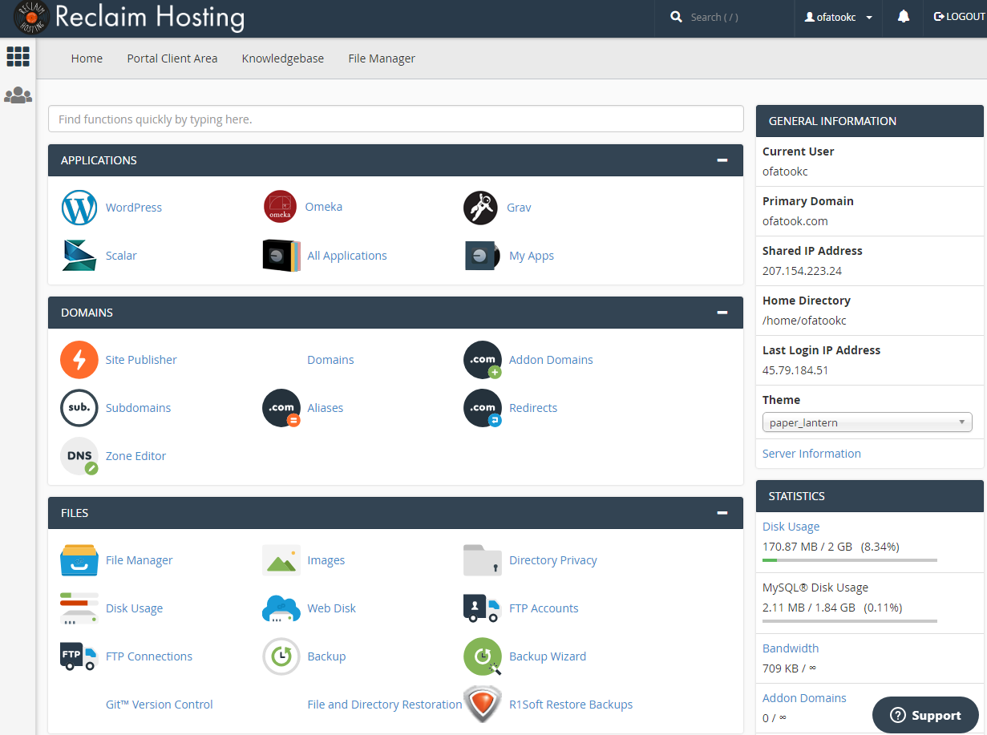
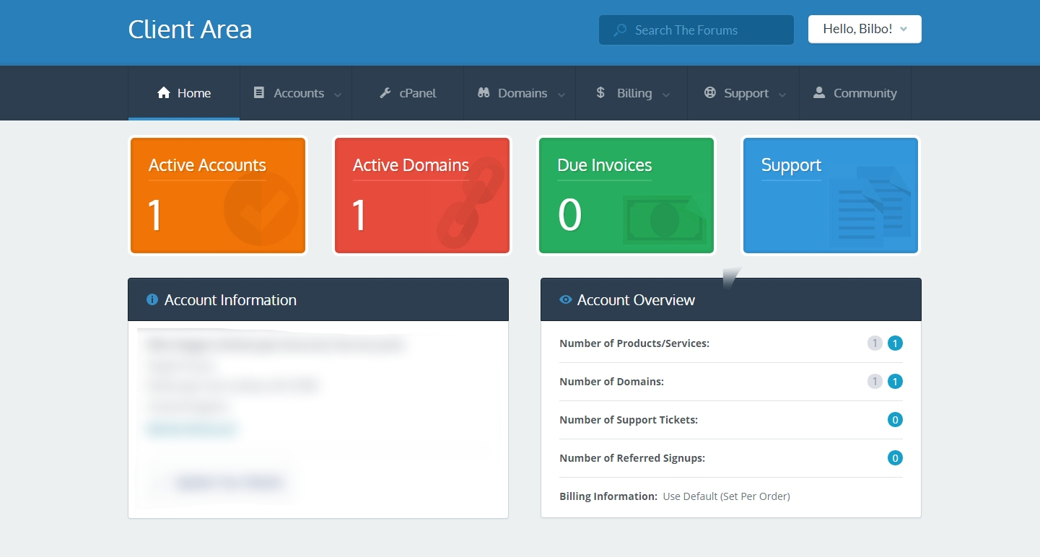
1] ACCESSING AND NAVIGATING C-PANEL
1] Access via Client Area on Reclaim Hosting
2] Click on cPanel
3] Click on WordPress

Slide 3
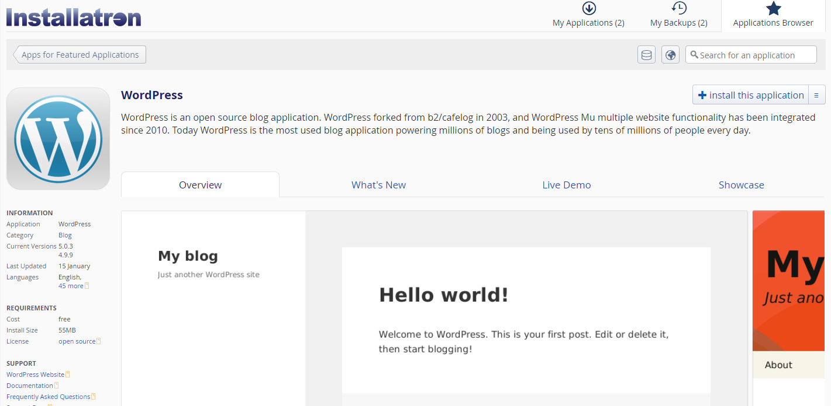
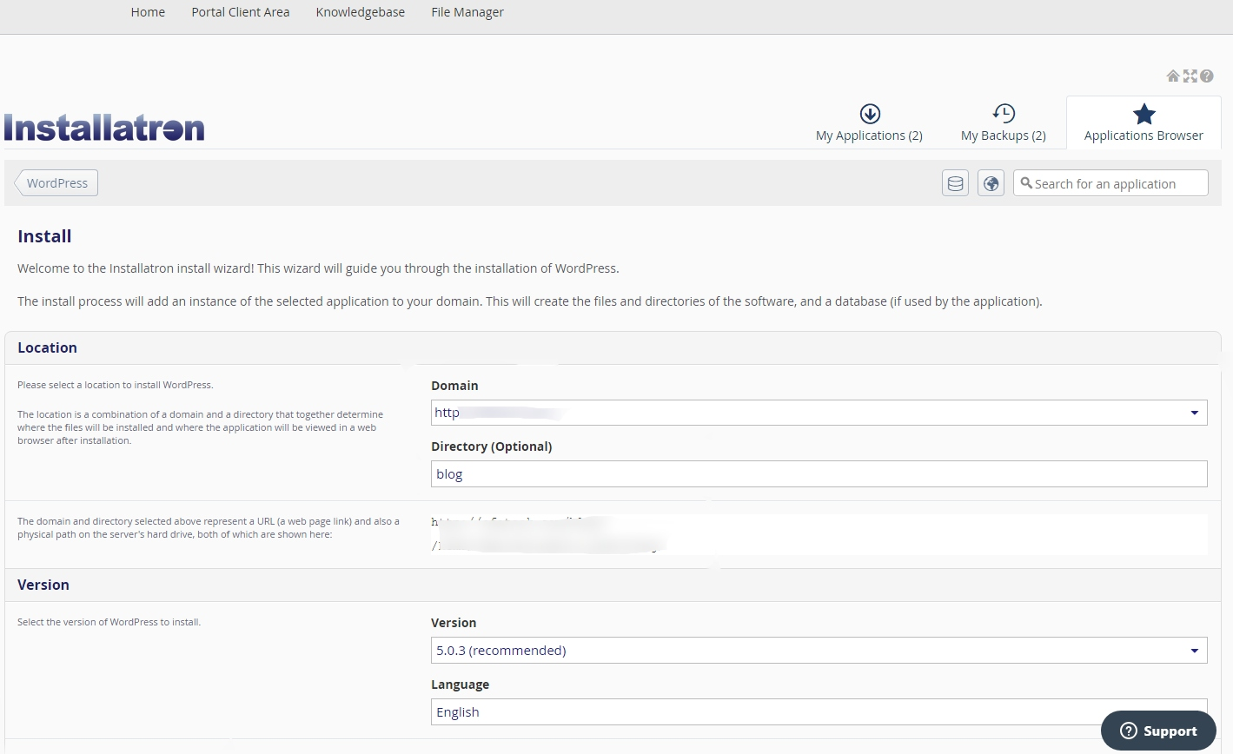
2] INSTALLING WORDPRESS [If you haven’t already!]

Slide 4
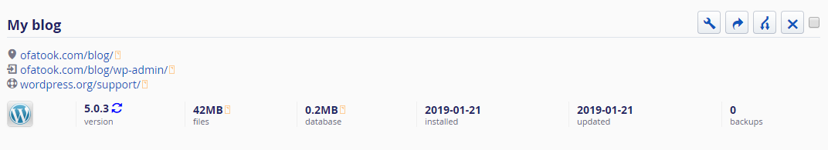
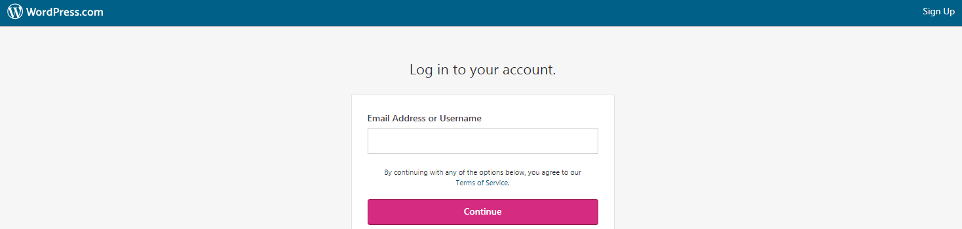
3] ACCESSING WORDPRESS
Access via cPanel
Access via WordPress.com

