Slide 1

Why Blog?
wocintech (microsoft) – 182, CC BY 2.0, https://flic.kr/p/Fv4HN8

Slide 2

develop your writing try different writing styles
Image by Brad Neathery on Unsplash

Slide 3

share your ideas connect with like minded people
wocintech stock – 65, CC BY 2.0. https://flic.kr/p/ER8m2S

Slide 4

disseminate & amplify your research increase exposure & impact
Pixabay, no attribution required, https://pixabay.com/en/laboratory-analysis-chemistry-2815641/

Slide 5

build a professional portfolio keep a record of your work
Photo by rawpixel on Unsplash

Slide 6
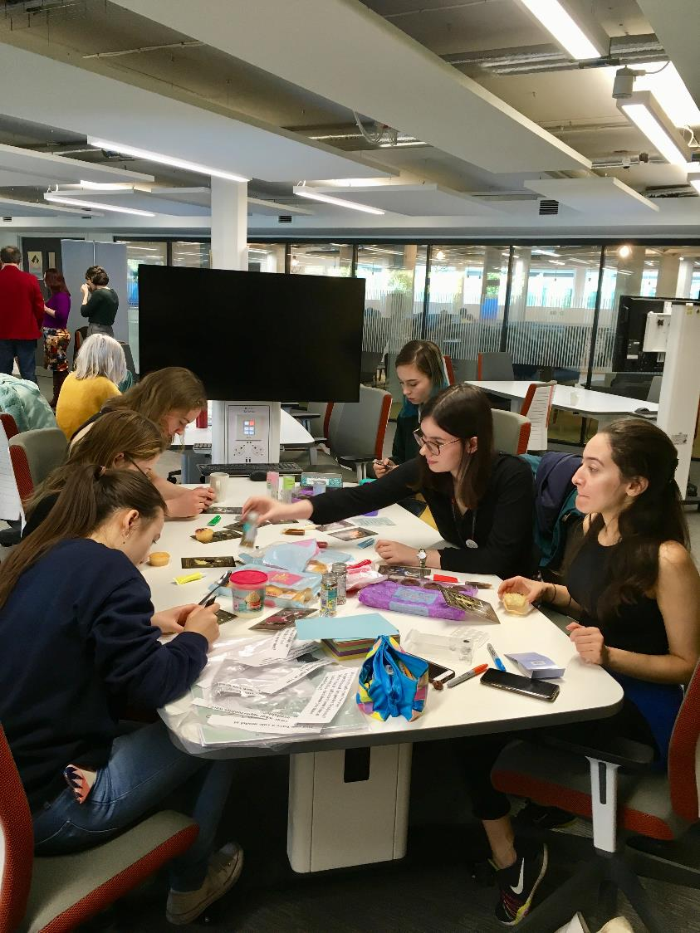
record events you’ve attended places you’ve been
Ada Lovelace Day 2018, University of Edinburgh, CC BY, Lorna M. Campbell

Slide 7

reflect on your learning
Photo by Hannah Olinger on Unsplash

Slide 8

keep a private journal
Photo by A L L E F . V I N I C I U S Δ on Unsplash

Slide 9

for fun!
Photo by Alejandro Alvarez on Unsplash

Slide 10

What should
I write about?
Pixabay, No Attribution Required

Slide 11

your learning
& research
Photo by LinkedIn Sales Navigator on Unsplash

Slide 12

events you’ve attended
ALTC 2018, Chris Bull for ALT, CC BY NC 2.0

Slide 13

places you’ve been
Kelvingrove Art Gallery, Glasgow, CC BY, Lorna M. Campbell

Slide 14

books & papers you’ve read
Photo by Jessica Castro on Unsplash

Slide 15

writing you’ve published
Into The Wild, CC BY, Lorna M. Campbell

Slide 16
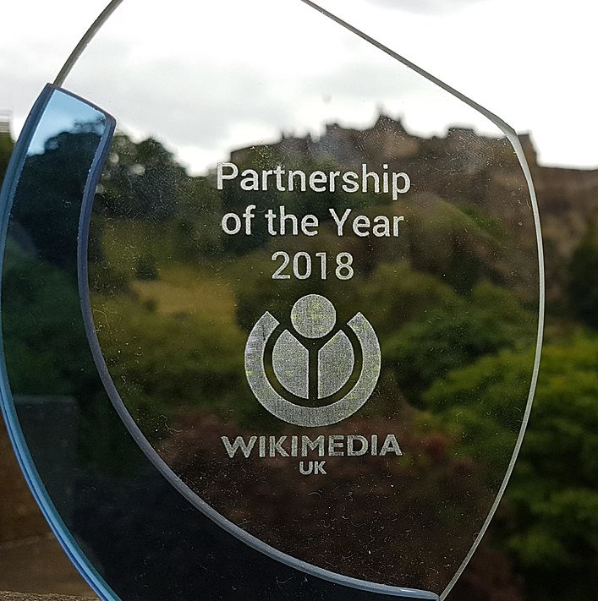
awards you’ve won
CCB SA 4.0, Ewan McAndrew, Wikimedia Commons

Slide 17

personal thoughts
& reflections
Photo by Kyle Gregory Devaras on Unsplash

Slide 18

films
Photo by MANSOOR 👑 on Unsplash

Slide 19
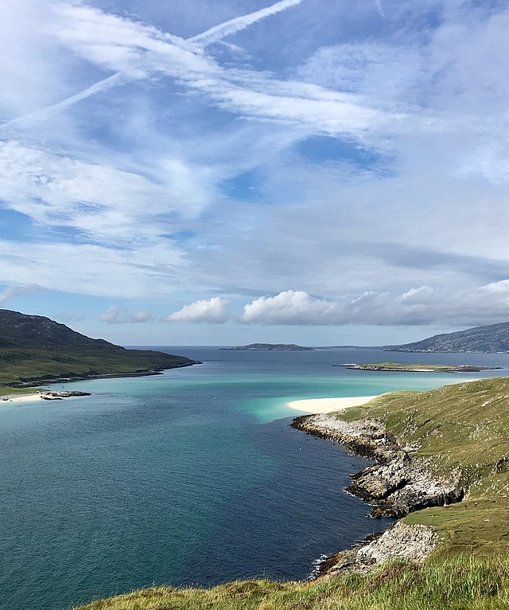
travel
Traigh Mheilein, CC BY, Lorna M. Campbell

Slide 20
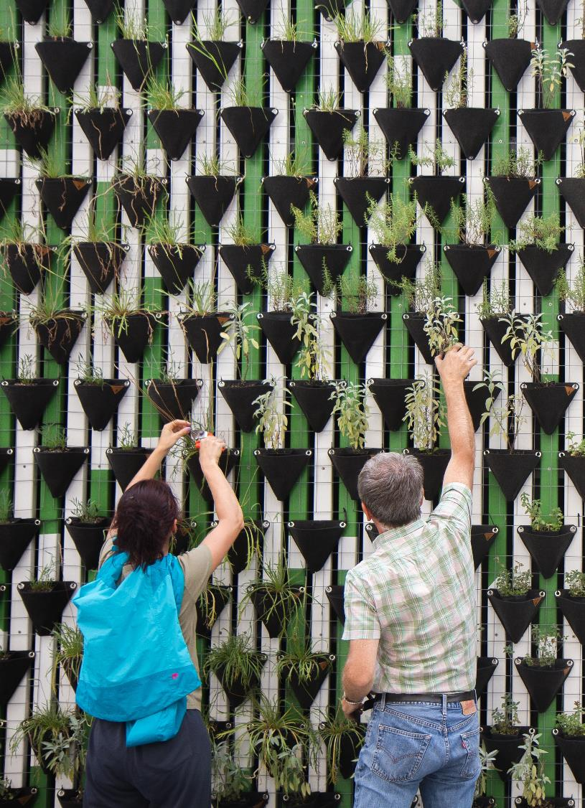
volunteering
Photo by Daniel Funes Fuentes on Unsplash

Slide 21

sport
Photo by David Marcu on Unsplash

Slide 22
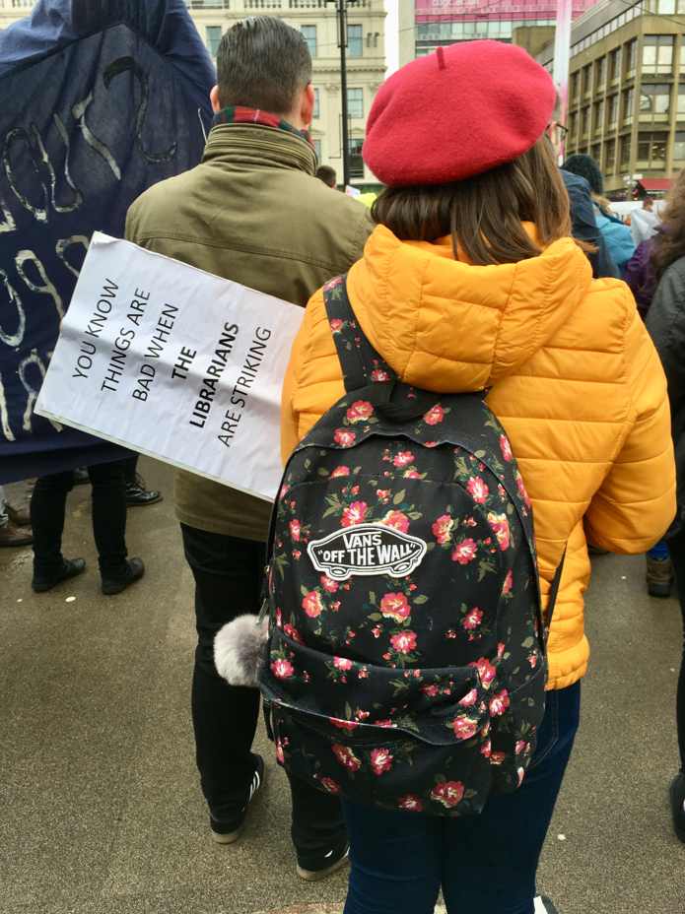
politics
UCU Strike Rally, Glasgow, CC BY, Lorna M. Campbell

Slide 23

gaming
Photo by Glenn Carstens-Peters on Unsplash

Slide 24

creative writing
Photo by Kinga Cichewicz on Unsplash

Slide 25
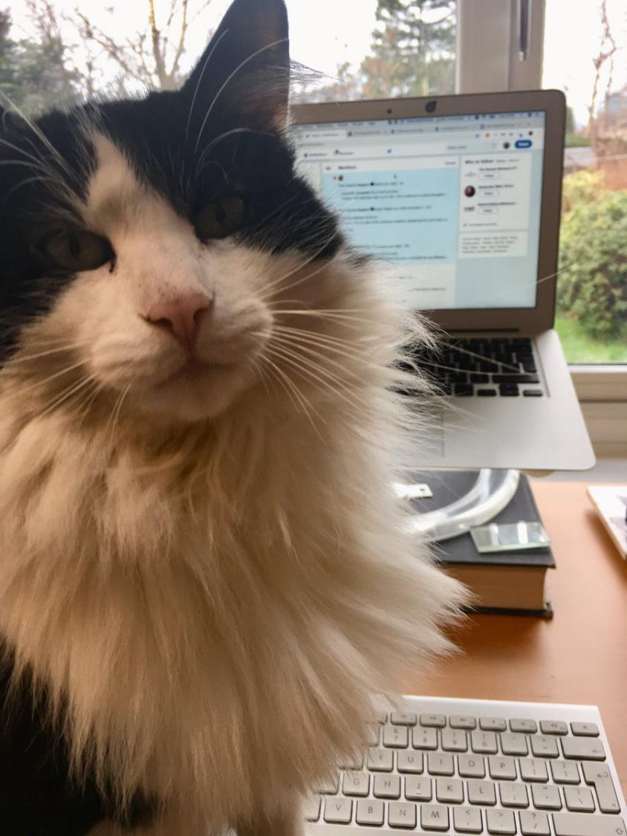
cats!
Josh, CC BY, Lorna M. Campbell

Slide 26
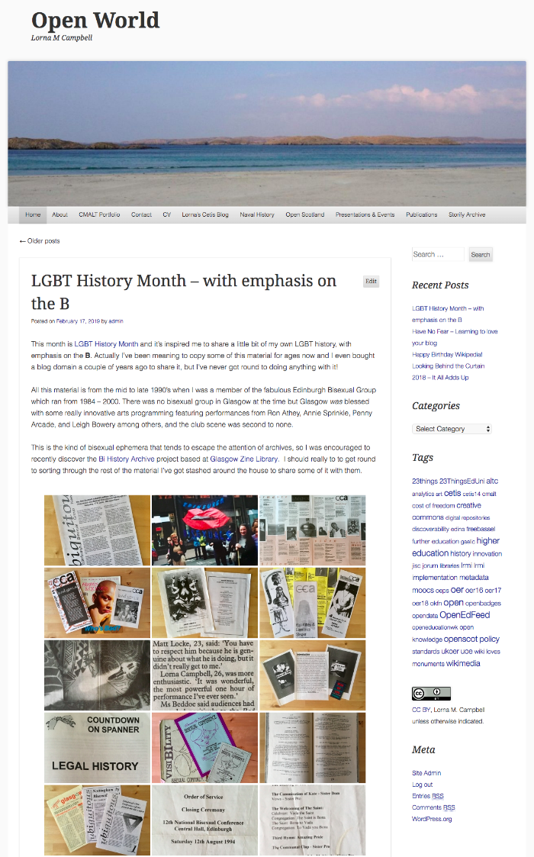
it’s your blog, make the most of it!
Open World, http://lornamcampbell.org/

Slide 27

Writing for blogs
Pixabay, No Attribution Required

Slide 28
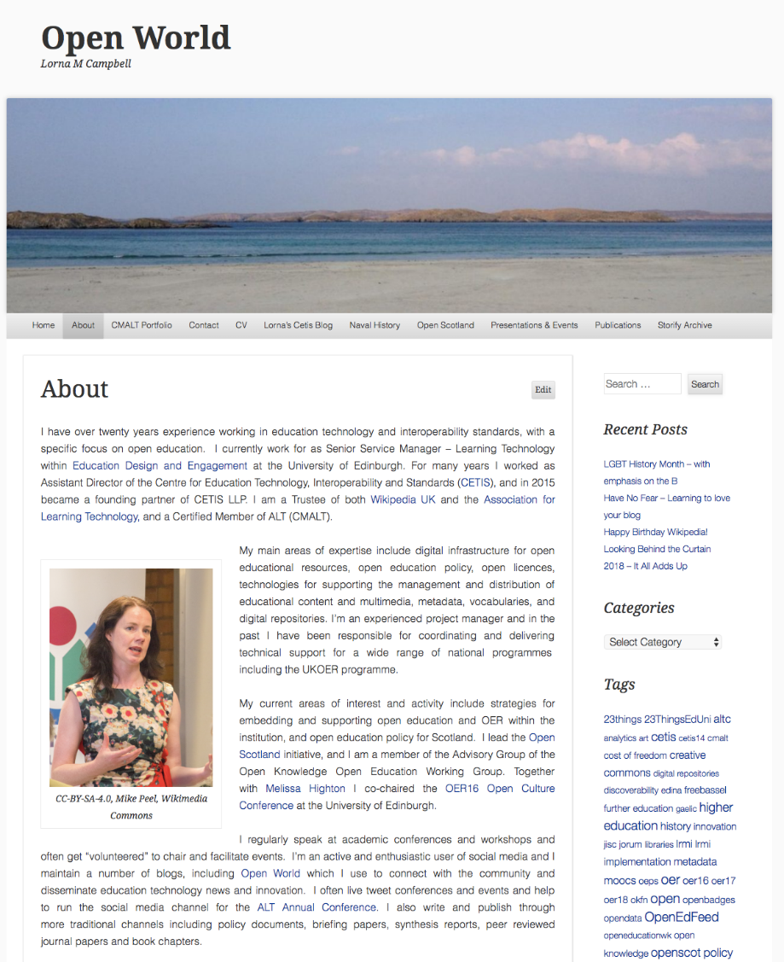
introduce yourself!
Open World, http://lornamcampbell.org/

Slide 29

short concise catchy title engaging opening paragraph
Pixabay, No Attribution Required

Slide 30

longer discursive posts are fine too
Photo by Nick Morrison on Unsplash

Slide 31

find your own voice experiment with different writing styles let your blog evolve
Photo by Jason Rosewell on Unsplash

Slide 32

think about your audience avoid jargon
& overly scholarly terms
Photo by davide ragusa on Unsplash

Slide 33

use images & media create a strong visual identity
Photo by Samuel Zeller on Unsplash

Slide 34

amplify your posts with social media the best blogs are part of a conversation
Photo by Clem Onojeghuo on Unsplash

Slide 35

be courteous think about what you write
Photo by Tiago Felipe Ferreira on Unsplash

Slide 36
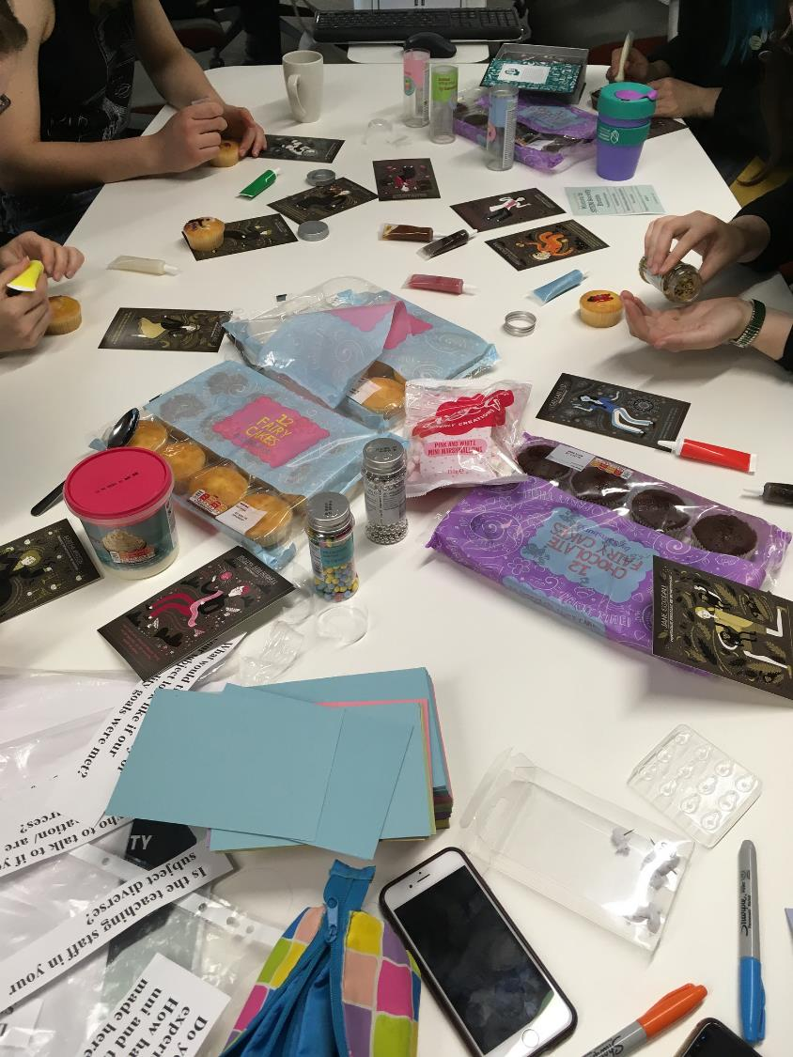
experiment be creative have fun : )
Ada Lovelace Day, University of Edinburgh, CC BY, Lorna M. Campbell

Slide 37


Lorna M. Campbell
OER Service
Information Services Group
University of Edinburgh
lorna.m.campbell@ed.ac.uk
https://open.ed.ac.uk/
http://lornamcampbell.org/
@LornaMCampbell
CC BY, Lorna M. Campbell, University of Edinburgh, unless otherwise indicated.

