Slide 1
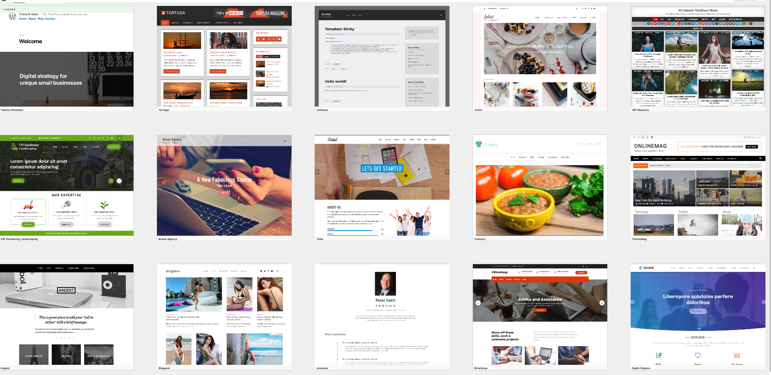
Customising your site

Slide 2
Why would you?
3000 themes available, and 44,000 plugins
Change look and feel of your site.
Make site more accessible (WP Accessibility).
Make your site more visible (XML Sitemap).
Make it more secure (Wordfence).
Reduce spam (Akismet, Cookies for comments).
Track usage (Google Aanlytics).

Slide 3
Really easy…
Functionality built right into Wordpress.

Slide 4
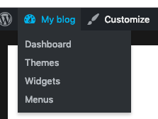
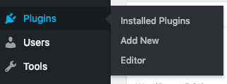
Adding a plugin
Go to Blogname > Dashboard
Then Plugins > Add New

Slide 5
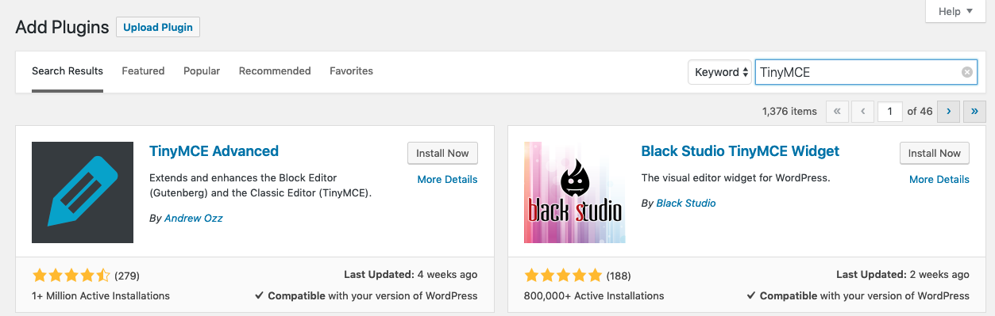
Adding a plugin
Search plugins
Or Upload plugin if you have .zip file

Slide 6
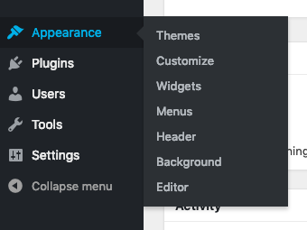

Adding a Theme
From the Dashboard select Appearance > Themes; or Customize from any page

Slide 7
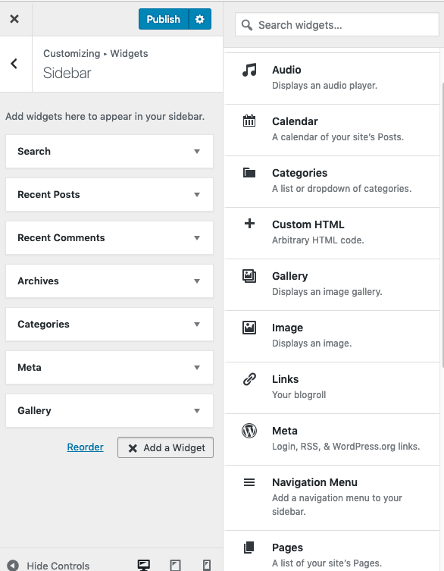
Add a Widget
Select Customize from any screen.
Click on Add Widget
Search or select Widget, and it will appear in your menu

